Slide 1
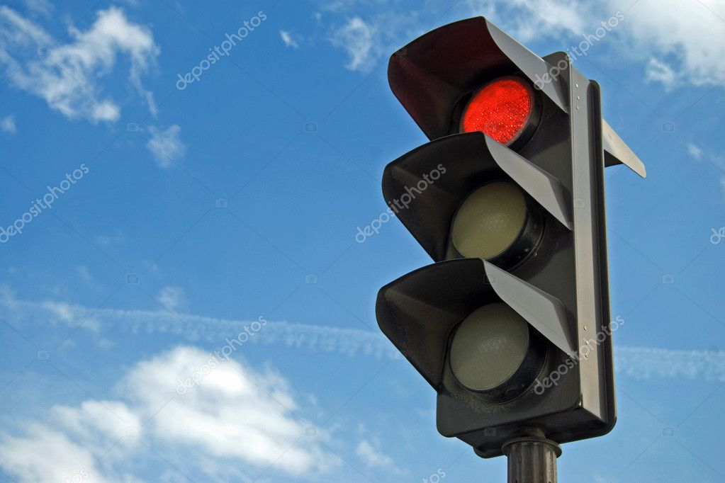
Components
Major components used for project are
220/9v center taped transformer
1N4001 Diode
1000uF capacitor
470uF capacitor (2pcs)
0.01uF capacitor (3pcs)
0.01uF capacitor (01)
7805 voltage regulator (01pcs)
555 Timer IC (02pcs)
547 DC transister

Slide 2
Components
10k resisters (04pcs)
1k resisters (01)
15 w ,230V ,Dim light

Slide 3
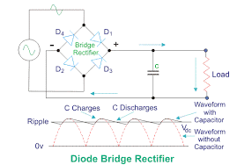
Components
A diode bridge is a arrangement of four diodes in a bridge circuit configuration that same polarity of output for either polarity of input.
It mostly used for conversion of Alternating current (AC) into Direct current (DC) ,is known as Bridge rectifier .
The essential feature of this arrangement is that it convert both cycle of Alternating current into Direct current
It also protect the circuit from (Reverse polarity)

Slide 4
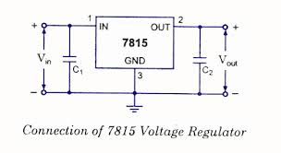
Components
Positive voltage regulator
7815 is a voltage regulator integrated circuit.
The voltage source in a circuit may have fluctuations and would not give the fixed voltage .
The regulator IC maintain the output at a constant level.
It provide 5V constant (DC )
The main feature is that it protect circuit from overloading

Slide 5
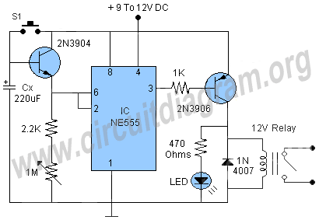
Components
The Timer IC (LM555)
The LM555 is a highly stable for generating accurate time delay or oscillation.
Additional terminals are provided for triggering and resetting if desired
By this we can adjust time from micro seconds to hours
It can be operate both in astableatate or monostablestate
It has good temperature stability

Slide 6
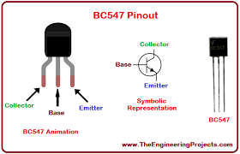
Components
Transistors
A BC547 transistor is a NPN transistor that is used for many purposes .
Togather with other components such as resisters ,coils and capacitor the BC547 can be used as active components for switches and amplifiers
we used in our project as a switch
In this we can adjust collector current by adjusting base current

Slide 7
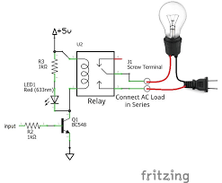
Components
Relay (5V )
A relay consist of two separate and completely independent circuit. The first is at bottom and drive the electromagnet
When the switch is on electromagnet is ON and it attract armature and armature acts as a switch for second circuit .
When the electromagnet is energized armature complete the circuit and light is ON and when electromagnet is not energized circuit is incomplete and light is OFF

Slide 8
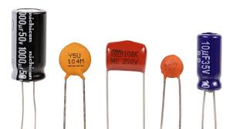
Components
Capacitor
Capacitor store electric charge . In this project they are with resister used as timing circuit because they take time to store charge
We are also using capacitor to convert alternating current (AC) into smooth Direct current (DC)
We are also using capacitor as filter because capacitor allow alternating current and block Direct current

Slide 9
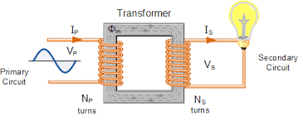
Components
Transformers
A transformer is an electrical device that transfer energy by inductive coupling between two or more of its windings .
Transformers are used for AC-to-AC conversion of single power frequency or for conversion of single power to a wide range of frequencies such as Audio or Radio frequencies
Its main purpose in circuit is to step up or set down voltage
We are using step down transfer in our circuit

Slide 10
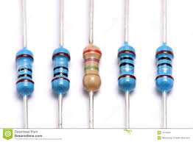
Components
Resister
Resister is a passive two-terminal electrical component that implements electrical resistance as a circuit element .
In electrical circuit resisters are used to reduce current flow ,adjust signal level, to divide voltages , bais active element and terminate transmission lines among us.
Resister are two types fixed resisters and variable resisters .we are using fixed resister to reduce current flow

Slide 11
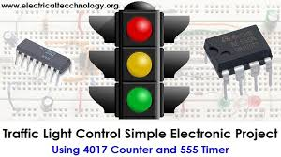
Components
LED BLUBS
LED blubs are electrical components that produce light
Light emitting diode (LED) is two terminal electrical component which is used for emitting light
Several LED are joined to make LED panel
In traffic control system three LED panel used as a sign of GREEN ,AMBER and RED

